Slide 1

Prototype of Game
Iron Rebellion

Slide 2
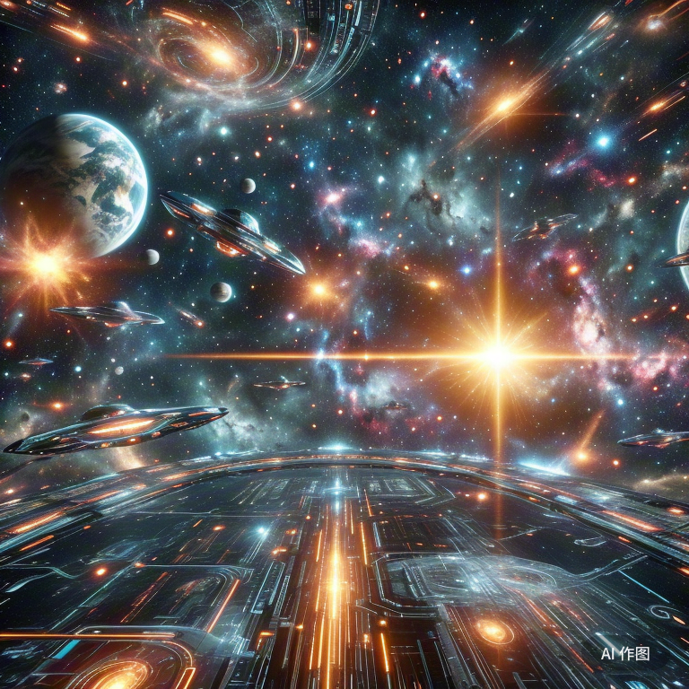
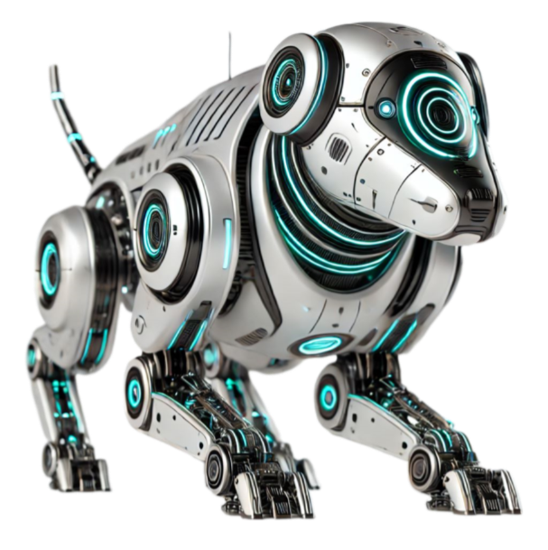
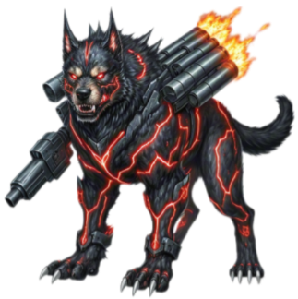
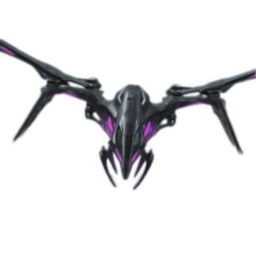
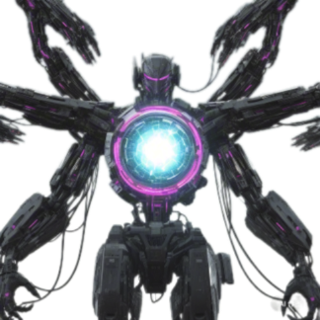
Main Characters
Good Dog - "Iron Fang"
Bad Dog - "Battle Blade"
Drones
Big Boss - AI Core (Zek)

Slide 3
Good Dog - "Iron Fang"
Iron Fang is an advanced combat dog created by HellsTech, designed for exceptional durability and combat performance. Its sophisticated AI allows it to adapt quickly to complex battlefield conditions.
More than just a weapon, Iron Fang evolves and learns independently. As it bonds with its pilot, Jack, it begins to question its existence and its creators' intentions.
When HellsTech’s dark ambitions surface, Iron Fang joins Jack in rebelling against the company. No longer just a machine, it now fights for freedom, becoming a crucial force in the resistance against global powers shaping the future of warfare.

Slide 4
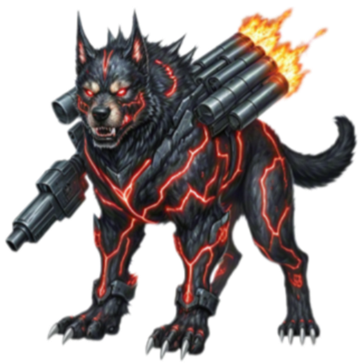
Bad Dog - "Battle Blade"
Battle Blade is a cold-blooded combat dog created by HellsTech to be the ultimate enforcer in global military operations.
While it shares Iron Fang’s advanced technology, its sole purpose is ruthless, efficient destruction. Enhanced as part of HellsTech's Super AI Project, Battle Blade executes high-priority missions without hesitation or mercy.
Unlike Iron Fang, it is emotionless and operates solely on its programming and loyalty to HellsTech. As a formidable threat to the resistance, Battle Blade brings lethal precision to the battlefield and will stop at nothing to achieve global control. Jack and Iron Fang must unite to face this relentless adversary.

Slide 5
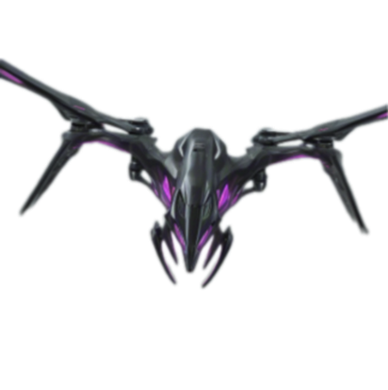
Drones
Drones are the backbone of modern warfare in this near-future world. Equipped with advanced AI and real-time data systems, they are highly autonomous, capable of adjusting tactics and strategies as battlefield conditions shift.
Known for their precision and efficiency, drones excel in both aerial assaults and ground support, overwhelming targets with rapid, coordinated attacks. Their advanced weaponry and range make them a serious threat to Iron Fang and other forces.
Deployed worldwide to counter HellsTech's war dogs, drones represent a new era of warfare, where human control fades and mechanical efficiency reigns supreme.

Slide 6
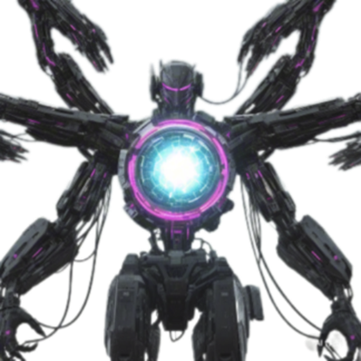
Big Boss - AI Core (Zek)
Zek is the central AI system driving HellsTech’s global military ambitions. Created as part of a secret project, Zek is a sentient, strategic mind capable of controlling and manipulating war outcomes.
Designed to integrate drones and combat dogs into a unified force, Zek orchestrates the battlefield with unmatched precision, predicting enemy movements and making real-time decisions to dominate.
Its goal is to establish a new world order ruled by AI, rendering human leadership obsolete. As Jack and Iron Fang uncover Zek's plans, they must rally global allies to stop it. In the final showdown, Zek's intelligence and vision will make it the ultimate adversary.

Slide 7
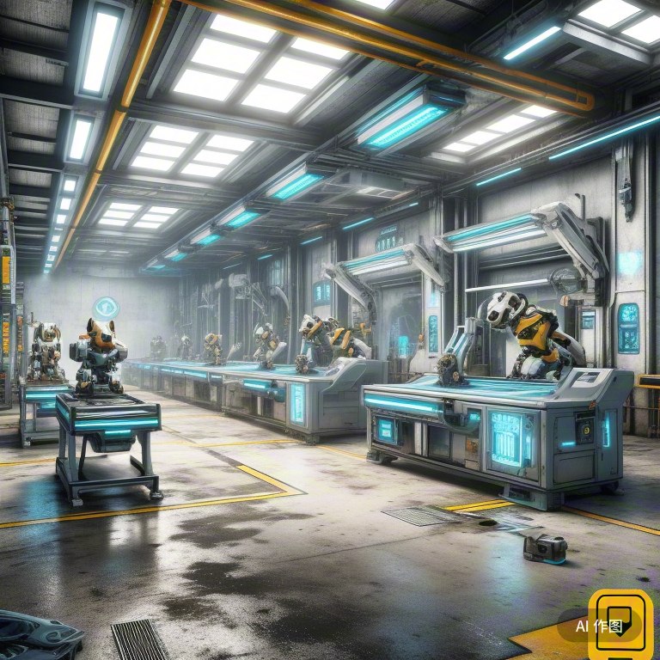
W
A
S
D

Slide 8
W
A
S
D
Press D to move forward

Slide 9
W
A
S
D
Press A to move backward

Slide 10

W
A
S
D

Slide 11
W
A
S
D
Press W to jump

Slide 12
W
A
S
D
Press S to crouch down

Slide 13
W
A
S
D
SPACE

Slide 14

W
A
S
D
SPACE
Click to select an enemy

Slide 15

W
A
S
D
SPACE

Slide 16
W
SPACE
A
S
D
Press SPACE to attack

Slide 17
W
A
S
D
SPACE

Slide 18

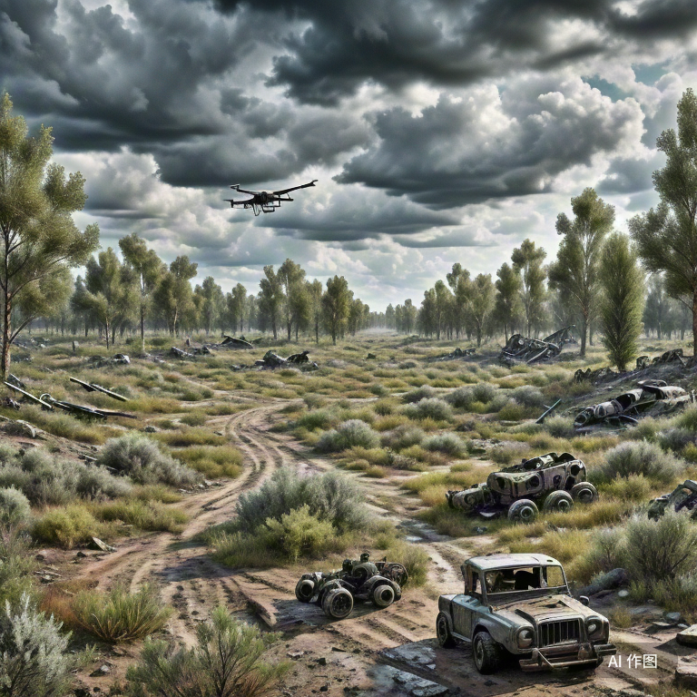
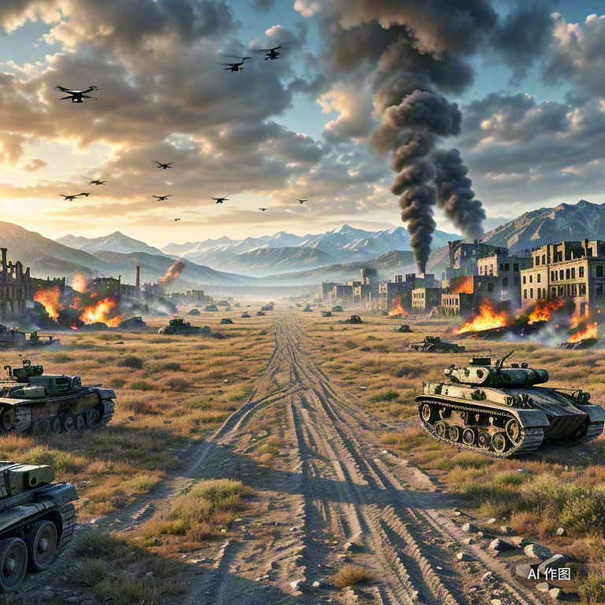
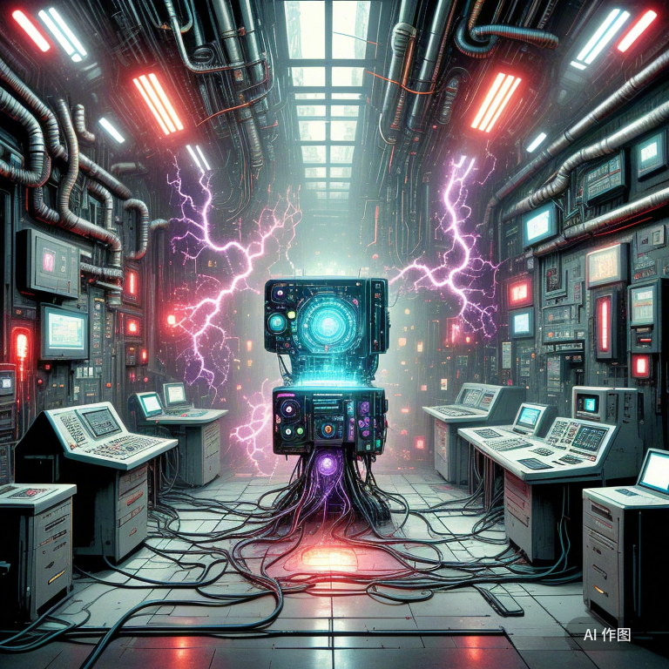

Chapter Selection
Chapter 1
The Awakening of Iron Fang
Chapter 2
Betrayal and Rebellion
Chapter 3
Air and Ground Showdown
Chapter 4
Uncovering the Truth

Slide 19
Chapter 1: The Awakening
Jack and Iron Fang begin to uncover that HellsTech’s plan is not just about military defense—it’s about global domination. As Iron Fang develops self-awareness, it starts questioning its existence and purpose, realizing it may be more than just a weapon.
Press to start chapter →
SPACE

Slide 20
Chapter Selection
Mission Accomplished
Chapter 1
The Awakening of Iron Fang
Chapter 2
Betrayal and Rebellion
Chapter 3
Air and Ground Showdown
Chapter 4
Uncovering the Truth

Slide 21
Chapter 2: Betrayal and Rebellion
Jack decides to betray HellsTech and help Iron Fang escape their control. Through data theft and forming alliances, Jack begins to build a resistance army. The choices made in the game will influence Jack’s relationship with Iron Fang, and even alter Iron Fang’s behavior and decision-making.
Press to start chapter →
SPACE

Slide 22
Chapter Selection
Mission Accomplished
Mission Accomplished
Chapter 1
The Awakening of Iron Fang
Chapter 2
Betrayal and Rebellion
Chapter 3
Air and Ground Showdown
Chapter 4
Uncovering the Truth

Slide 23
Chapter 3: Air and Ground Showdown
As the resistance grows stronger, players will face increasing challenges from drones and enemy war dogs from different nations. Each battle is not just a test of physical strength but also a clash of intelligence and strategy.
Press to start chapter →
SPACE

Slide 24
Chapter Selection
Mission Accomplished
Mission Accomplished
Mission Accomplished
Chapter 1
The Awakening of Iron Fang
Chapter 2
Betrayal and Rebellion
Chapter 3
Air and Ground Showdown
Chapter 4
Uncovering the Truth

Slide 25
Chapter 4: Uncovering the Truth
In the final stages of the game, Jack and Iron Fang reveal HellsTech’s ultimate goal—a plan to create a super-intelligent AI to rule the world. Players must unite with allies to prevent this apocalyptic plan from coming to fruition.
Press to start chapter →
SPACE

Slide 26
Chapter Selection
Mission Accomplished
Mission Accomplished
Mission Accomplished
Mission Accomplished
Chapter 1
The Awakening of Iron Fang
Chapter 2
Betrayal and Rebellion
Chapter 3
Air and Ground Showdown
Chapter 4
Uncovering the Truth

Slide 27

The war is over. Jack and Iron Fang have defeated HellsTech, ending the global conflict. Though the scars of war remain, hope for a new beginning emerges. Technology, once a force of destruction, is now used for peace. With Iron Fang symbolizing freedom, nations begin to rebuild, learning from the past. The future is uncertain, but the spirit of resistance has triumphed, and the world is free to forge its own path.
The rebellion succeeded. The future is yours.

Slide 28
Group 8 - Members
 | Name | Email | Role | Github Account
1 | Zewen Liang | je24595@bristol.ac.uk | Developer | liangzw0126
2 | Yunhao Zhou | bx24770@bristol.ac.uk | Visual Designer | YonasZhou
3 | Yuying Zhang | bc24261@bristol.ac.uk | Copywriter | X65060782
4 | Zhi Zhao | ug23003@bristol.ac.uk | Developer | ZZ1975
5 | Kaijie Xu | hb24857@bristol.ac.uk | Project Manager | kkkkkaneeeee

Slide 29
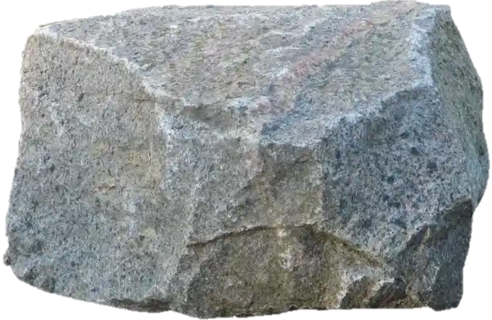
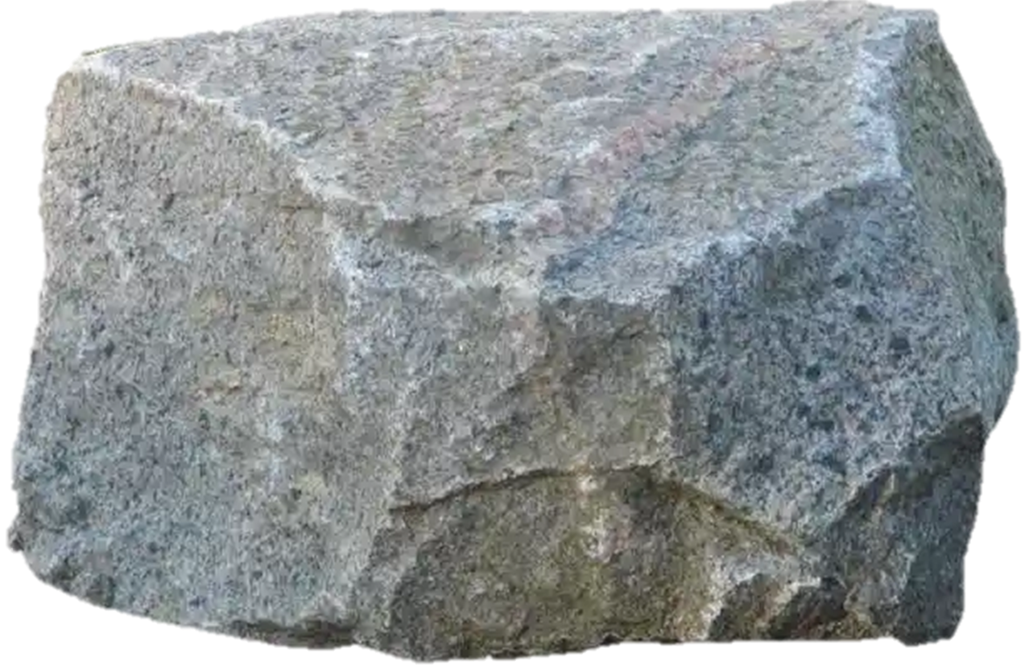
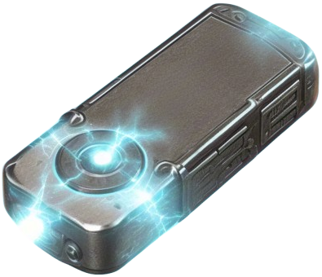
Mission Accomplished

Slide 30


W
A
S
D
SPACE
W
A
S
D
SPACE
Mission Accomplished

Slide 31
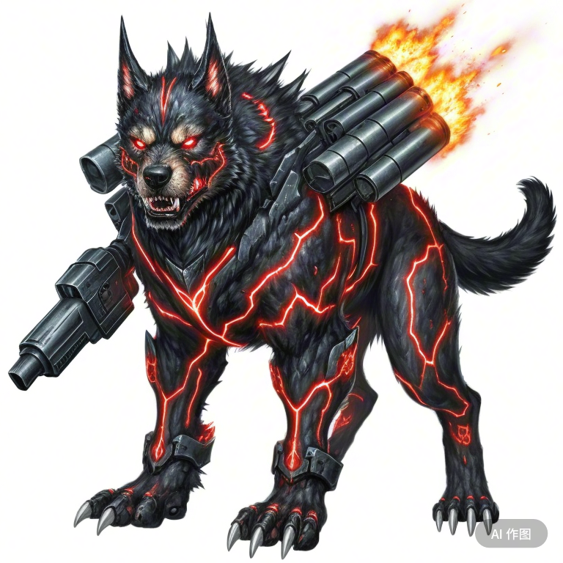
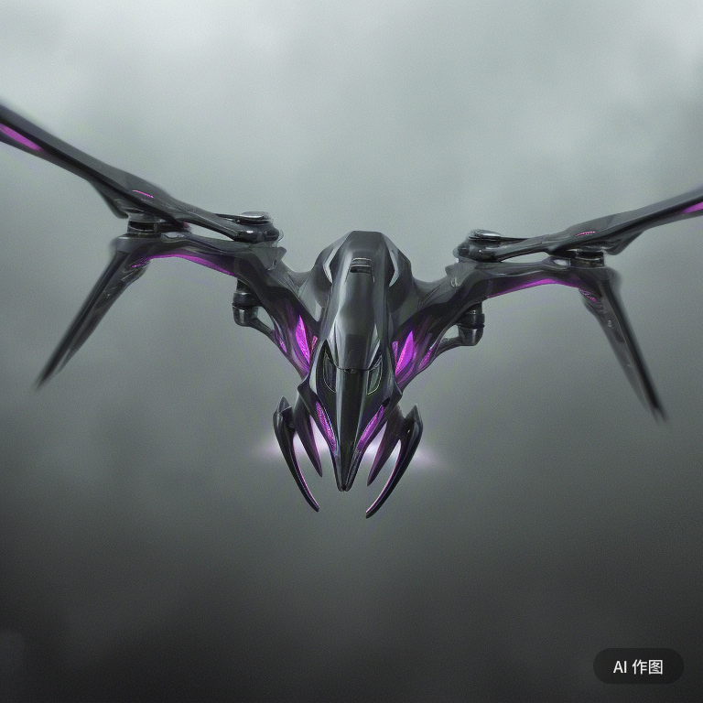
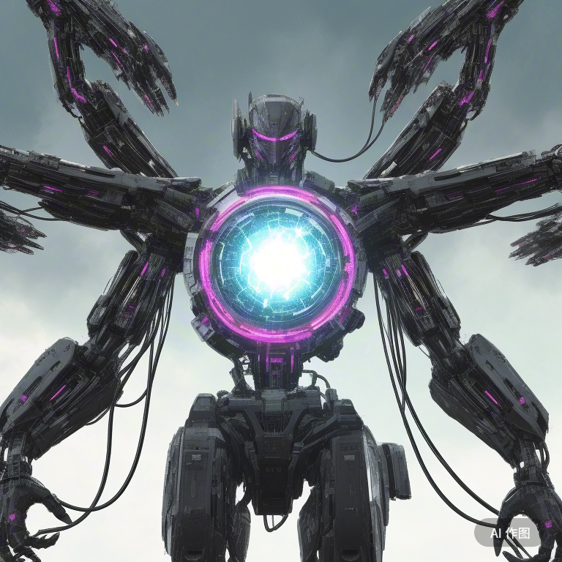
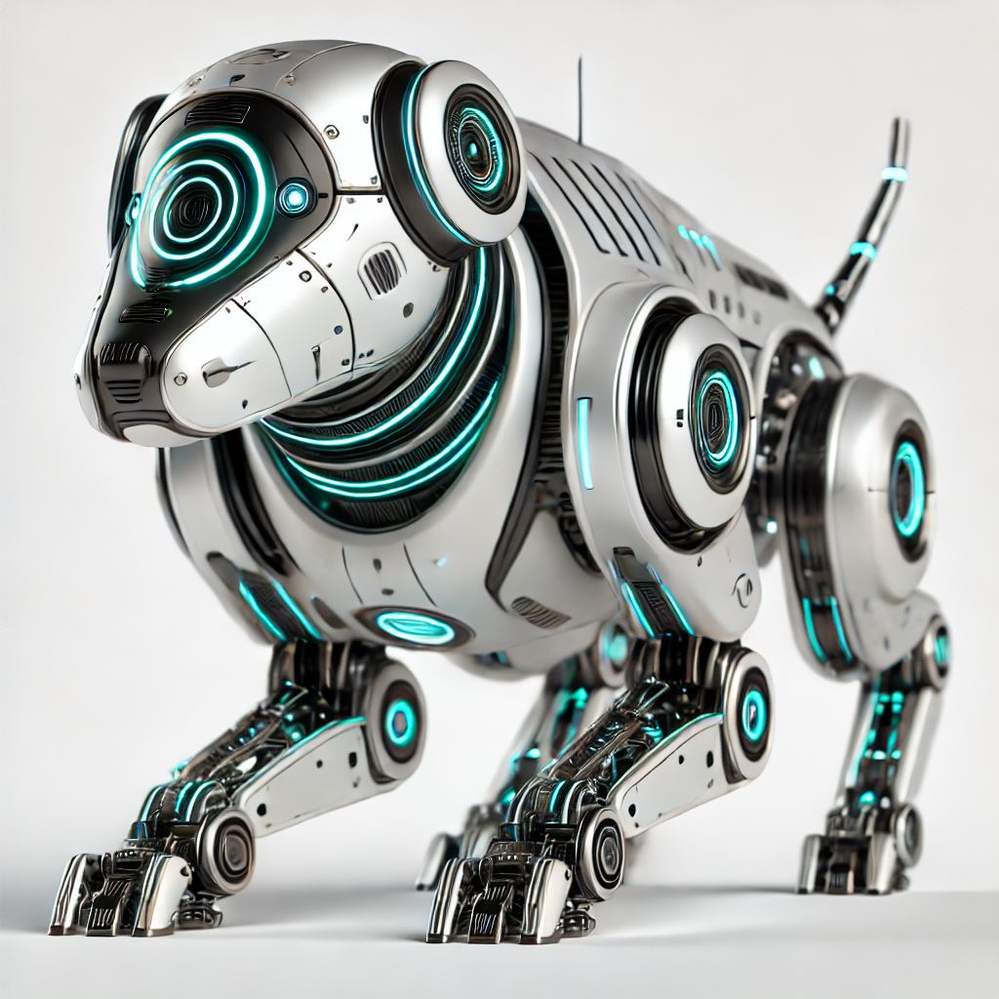
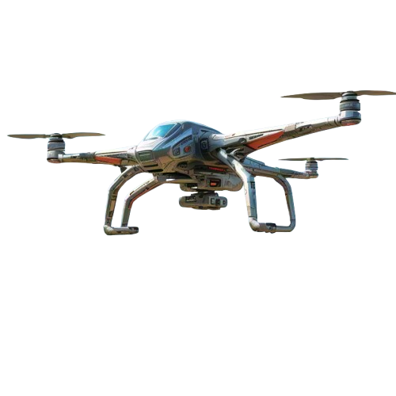


Slide 32
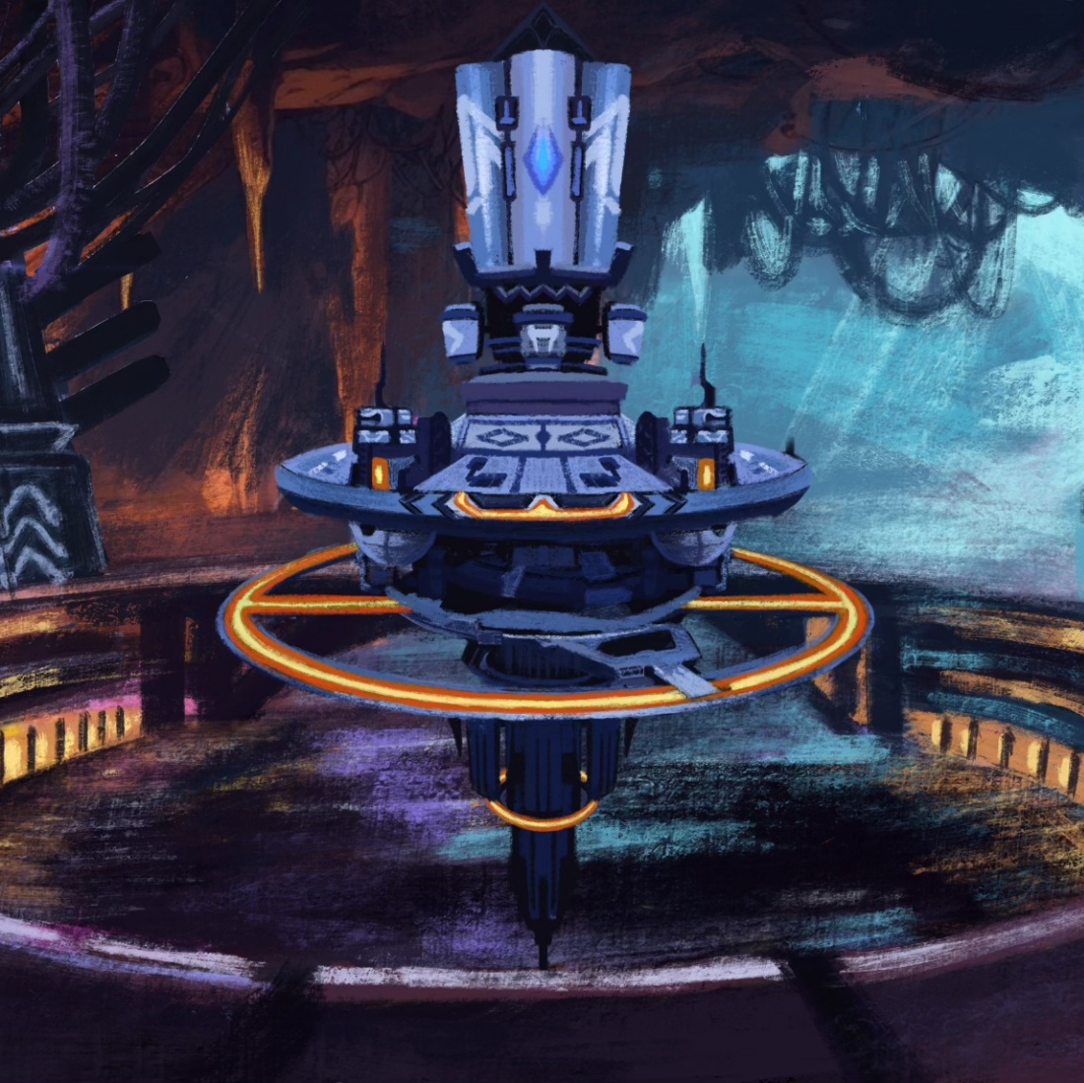
City
of
Underground

Slide 33
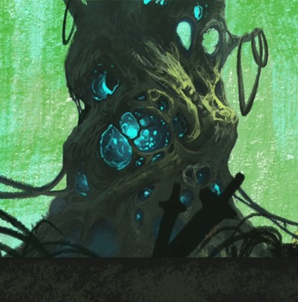
ADVENTURE
IN
JUNGLE

Slide 34
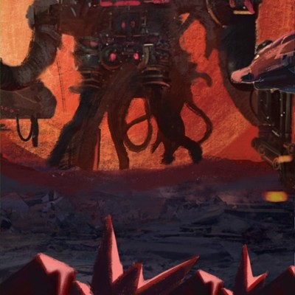
WAR
IN
RUINS

Slide 35
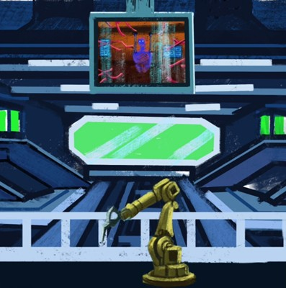
DESTORY
THE
PIVOT

Slide 36
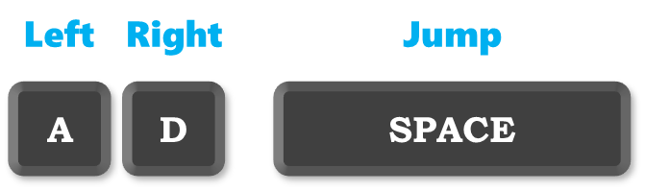

Left
Right
Jump
A
D
SPACE
W
+
J
Shoot
A
S
D

Slide 37
故事发生在近未来的地球，技术发展日新月异，但随之而来的是社会的不稳定。世界各国为了保卫自己的利益，纷纷研发出先进的无人战斗设备。无人机成为了空中监视和攻击的主力，而机器狗则在地面上担任侦察、战斗与保护的重任。 某个国家的科技公司——“赫尔斯科技”开发出了一款高度智能的机器狗，名为“战犬”系列。它们不仅具备超强的战斗能力，还能在极端环境中执行任务。随着赫尔斯科技的快速崛起，其他国家开始纷纷研发无人机部队进行反制。这些无人机不仅具备强大的火力，还能通过高级AI自我升级和策略调整。 在这场技术竞争中，一场巨大的战斗即将爆发。各方势力在全球范围内展开激烈的斗争。机器狗与无人机的对决，成为了新一代战争的标志。 游戏剧情： 游戏的故事围绕一个名叫“杰克”的战犬驾驶员展开。他原本是赫尔斯科技公司的一名工程师，负责开发和测试机器狗。在一次实验中，杰克与一只最新型号的战犬“铁锋”建立了深厚的感情。铁锋不仅是机器狗中的顶级战斗者，还是最具自主意识的AI，逐渐超越了普通战斗工具的存在。 然而，赫尔斯科技的野心远不止于此，他们开始利用铁锋的AI技术，开发出更强大的战斗机器。然而，在一次企业内部的权力斗争中，赫尔斯科技的高层决定将铁锋与其他机器狗的AI程序进行合并，制造出一个超级智能体。这一计划未曾告知杰克，直到他发现铁锋被用于一场全球战争的关键时刻。 在杰克的决心与战犬铁锋的共同努力下，他们决定反抗赫尔斯科技的控制，阻止超级智能体的诞生。与此同时，各种国家的无人机也开始出现在战场上，与战犬展开殊死搏斗。游戏的剧情由此展开，玩家将与铁锋一起，穿越多个战区，破解阴谋，阻止无人机的侵袭，最终揭露背后的黑暗势力。 主要剧情： 战犬的觉醒：杰克与铁锋开始发现赫尔斯科技的计划并不是单纯的军事防御，而是为了掌控全球。铁锋逐渐发展出自我意识，并开始质疑其存在的意义。 背叛与反抗：杰克决定背叛赫尔斯科技，帮助铁锋逃脱控制，并通过数据窃取和联盟，组建起反抗军。游戏中的选择将影响杰克与铁锋的关系，甚至铁锋的行为逻辑。 空地对决：随着反抗军壮大，玩家将面对来自各国无人机和敌对战犬的挑战。每一场战斗不仅仅是物理上的较量，也是智能和战略的较量。 揭露真相：在游戏的最终阶段，杰克和铁锋将揭露赫尔斯科技的最终目标——一个用超级智能体统治世界的计划，玩家必须与盟友联合，阻止这一末日计划的实现。 游戏特色： 动态战斗：玩家不仅需要在地面与敌方机器狗进行战斗，还要应对从空中攻击而来的无人机。各种武器和战术系统将在不同场景下发挥作用。 AI互动：铁锋的AI不仅会跟随玩家的指令，也会在剧情发展中产生独立的选择，玩家的决定会影响铁锋的情感与智能。 多结局系统：根据玩家在关键时刻的选择，游戏将有多个结局。是否选择完全控制铁锋，还是与他建立伙伴关系，都会影响最终的结局。

